Slide 1

Algorithm: Local Hill Climbing
Ankur Roy Chowdhury
CSCE 625 (S’18) Artificial Intelligence
Notes:
Hi everyone. My name is Ankur, and I am going to talk about my implementation of the Local Hill Climbing algorithm for project 1.

Slide 2
Algorithm Details
Look at the 8 neighbor cells for the highest value
If a tie:
Compute Euclidean distance from Highest probability cell (HPC)
Compute distance of the 8 neighbors from HPC
Choose cell with minimum distance
Terminate when CDP is 1
Notes:
The local hill climbing algorithm works by choosing the highest valued cell from amongst it’s 8 neighbours.
If such a cell is not found, or if there is a tie, we compute the Euclidean distance from the current cell to the next highest probability cell. There could be many such cells with the highest probability, so we choose the one that is nearest.
Finally, we select the cell from the 8 neighbours which has the least distance from the selected highest probability cell. We terminate when the probability accumulated is 1.

Slide 3
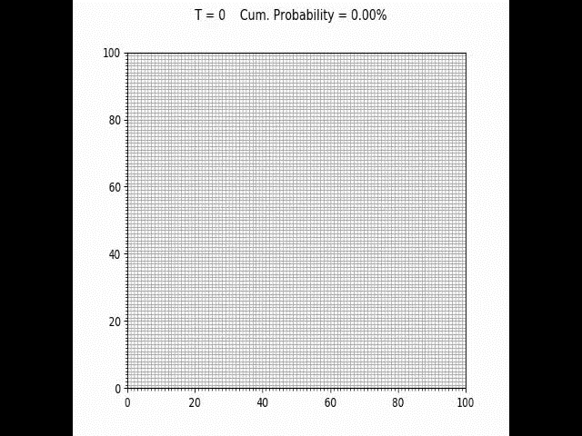
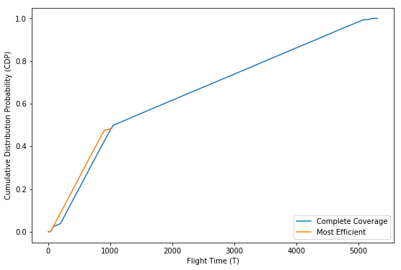

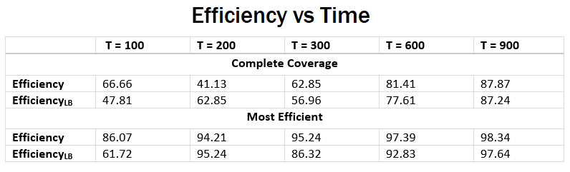
Heatmap 1
CDP vs Time
Notes:
Now let’s look at the performance of the algorithm with respect to the heatmaps.
On the left we have the path generated by the algorithm for the heatmap located on the upper left corner of the grid. On the right we have the cumulative probability vs time graph.
Initially, the algorithm tries to reach a node with some probability measure. It heads in the direction of highest probability measure, until it finds nodes with suboptimal probability measure. Due to the greedy nature of the algorithm it gets stuck there for sometime. However, due to the global warming effect, it breaks away from the local minima.
As can be seen from the efficiency table, the algorithm starts off poorly. This can be attributed to the fact that initially it got stuck in a local maximum. However, the efficiency increase with time and by t = 900 we have measures consistent with the paper.

Slide 4


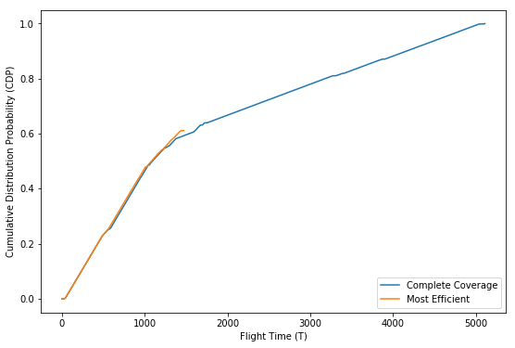
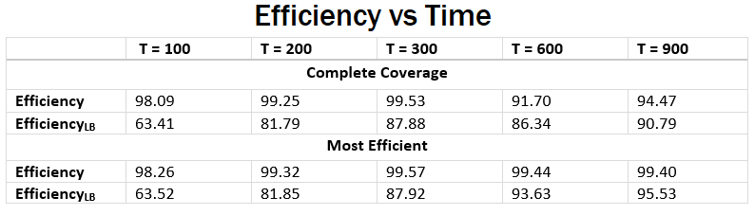
Heatmap 2
CDP vs Time
Notes:
Here we have the path for the second heatmap.
Our algorithm performs much better than the previous heatmap. This is due to the fact that it does not get stuck in a local maximum initially.
The orange plot on the right represents the cumulative detection probability for the most efficient path. The most efficient path here is the path that is concerned not with complete coverage, but with maximum coverage given a fixed amount of time. It can be used when time needed for complete coverage is more than can be afforded. This path is a byproduct of the global warming step.

Slide 5
Discussion of the algorithm
Works as expected
Low computation cost
Can get stuck in Local maxima
Heuristics like Mode Goodness Ratio
Notes:
So, the key takeaways are:
The algorithm worked as expected.
It did get stuck in local maxima, which effected our efficiency. However, due to the “global warming” step, it did break out of those local maxima fairly quickly.
Another byproduct of the global warming step is, provided complete coverage is not a criteria, but time is, we could figure out the best possible path that maximises the detection probability for the given time. As seen by the ‘most efficient’ graphs for the respective heatmaps, a couple of slides back.
To summarise, the LHC algorithm is computationally fast and quite adaptive to changes. However, it does get stuck in local maxima.
To improve upon it we could come up with better heuristics like Mode Goodness Ratio, which prioritizes multi-modal distributions into sub-regions for the uav to visit, thus, eliminating the guesswork involved in determining whether the peak is a local or a global maxima.
Thtat conludes my discussion. Thank you.

Slide 6



